Slide 1
Generative ML
CS771: Introduction to Machine Learning
Purushottam Kar

Slide 2
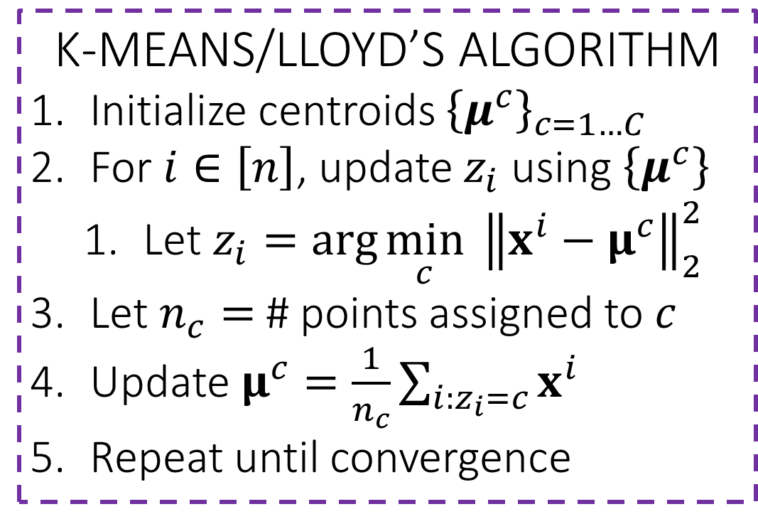
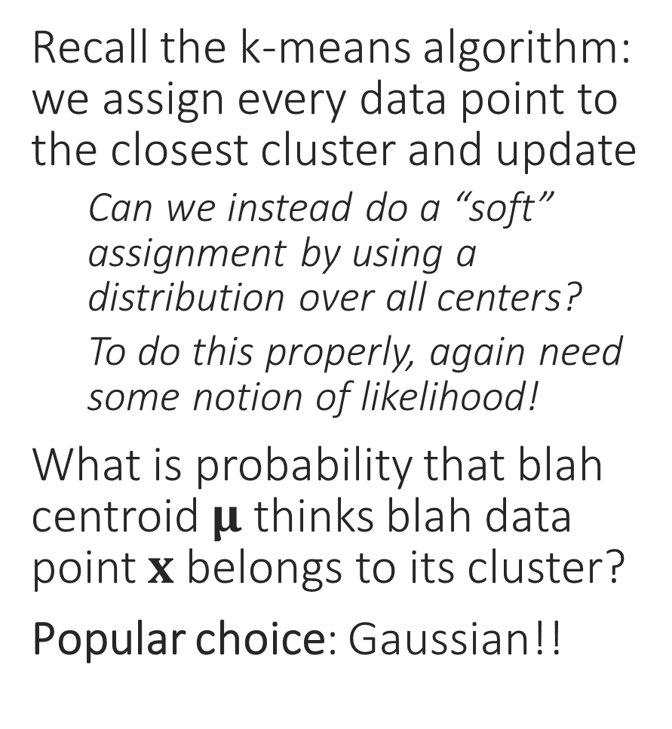
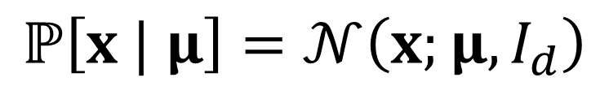
Probabilistic Clustering??
Recall the k-means algorithm: we assign every data point to the closest cluster and update
Can we instead do a “soft” assignment by using a distribution over all centers?
To do this properly, again need some notion of likelihood!
What is probability that blah centroid $μ$ thinks blah data point $x$ belongs to its cluster?
Popular choice: Gaussian!!
K-MEANS/LLOYD’S ALGORITHM
Initialize centroids ${\left\{μ^{c}\right\}}_{c=1…C}$
For $i∈\left[n\right]$, update $z_{i}$ using $\left\{μ^{c}\right\}$
Let $z_{i}=\arg{\min_{c}{ {\left\|x^{i}−μ^{c}\right\|}_{2}^{2}}}$
Let $n_{c}=$ # points assigned to $c$
Update $μ^{c}=\frac{1}{n_{c}}\sum_{i:z_{i}=c}{x^{i}}$
Repeat until convergence
$$ℙ\left[x | μ\right]=𝒩\left(x;μ,I_{d}\right)$$

Slide 3



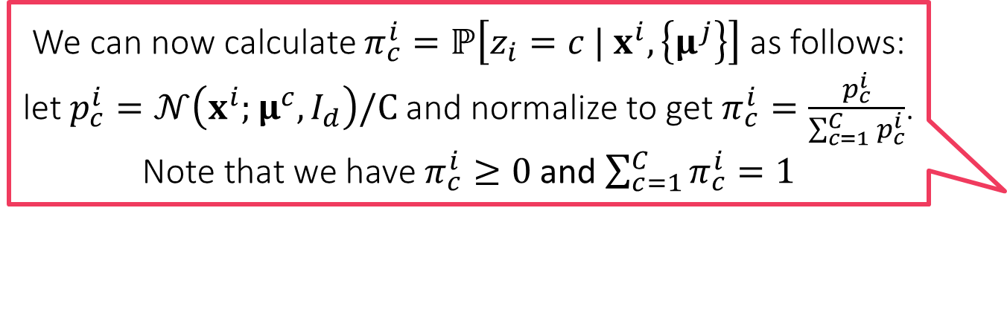
Soft k-means
We can now calculate $π_{c}^{i}=ℙ\left[z_{i}=c | x^{i},\left\{μ^{j}\right\}\right]$ as follows: let $p_{c}^{i}=𝒩\left(x^{i};μ^{c},I_{d}\right)/C$ and normalize to get $π_{c}^{i}=\frac{p_{c}^{i}}{\sum_{c=1}^{C}{p_{c}^{i}}}$. Note that we have $π_{c}^{i}≥0$ and $\sum_{c=1}^{C}{π_{c}^{i}}=1$
SOFT K-MEANS ALGORITHM
Initialize means ${\left\{μ^{c}\right\}}_{c=1…C}$
For $i∈\left[n\right]$, update $π_{c}^{i}$ using $\left\{μ^{c}\right\}$
Let $p_{c}^{i}=\exp\left(−\frac{{\left\|x^{i}−μ^{c}\right\|}_{2}^{2}}{2}\right)$
Let $π_{c}^{i}=\frac{p_{c}^{i}}{\sum_{c=1}^{C}{p_{c}^{i}}}$ (normalize)
Let $n_{c}=\sum_{i=1}^{n}{π_{c}^{i}}$
Update $μ^{c}=\frac{1}{n_{c}}\sum_{i=1}^{n}{π_{c}^{i}⋅x^{i}}$
Repeat until convergence
At every time step, every data point, instead of choosing just one cluster i.e. one value of $z_{i}∈\left[C\right]$, instead chooses a distribution over all clusters i.e. a dist. over all $C$ possible values of $z_{i}$ ($\left\{μ^{j}\right\}$ denotes $\left\{μ^{1},…,μ^{C}\right\}$)
Use Bayes rule $ℙ\left[z_{i}=c | x^{i},\left\{μ^{j}\right\}\right]∝ℙ\left[x^{i} | z_{i}=c,\left\{μ^{j}\right\}\right]⋅ℙ\left[z_{i}=c | \left\{μ^{j}\right\}\right]$
Since we chose Gaussian likelihoods, $ℙ\left[x^{i} | z_{i}=c,\left\{μ^{j}\right\}\right]∝𝒩\left(x^{i};μ^{c},I_{d}\right)$
For sake of simplicity, we assume $ℙ\left[z_{i}=c | \left\{μ^{j}\right\}\right]=ℙ\left[z_{i}=c\right]=1/C$
i.e. assume that until we see data, all clusters are equi-probable
Once “partial” assignments are made, proceed to centroid update step
Pretend that $π_{c}^{i}$-th portion of the $i$-th data point went to $c$-th cluster
“Number” of points assigned to cluster $c$ becomes $n_{c}=\sum_{i=1}^{n}{π_{c}^{i}}$
Rest of the update modified accordingly $μ^{c}=\frac{1}{n_{c}}\sum_{i=1}^{n}{π_{c}^{i}⋅x^{i}}$
A much more principled derivation of this algorithm exists in the form of the EM algorithm which we will study soon!

Slide 4
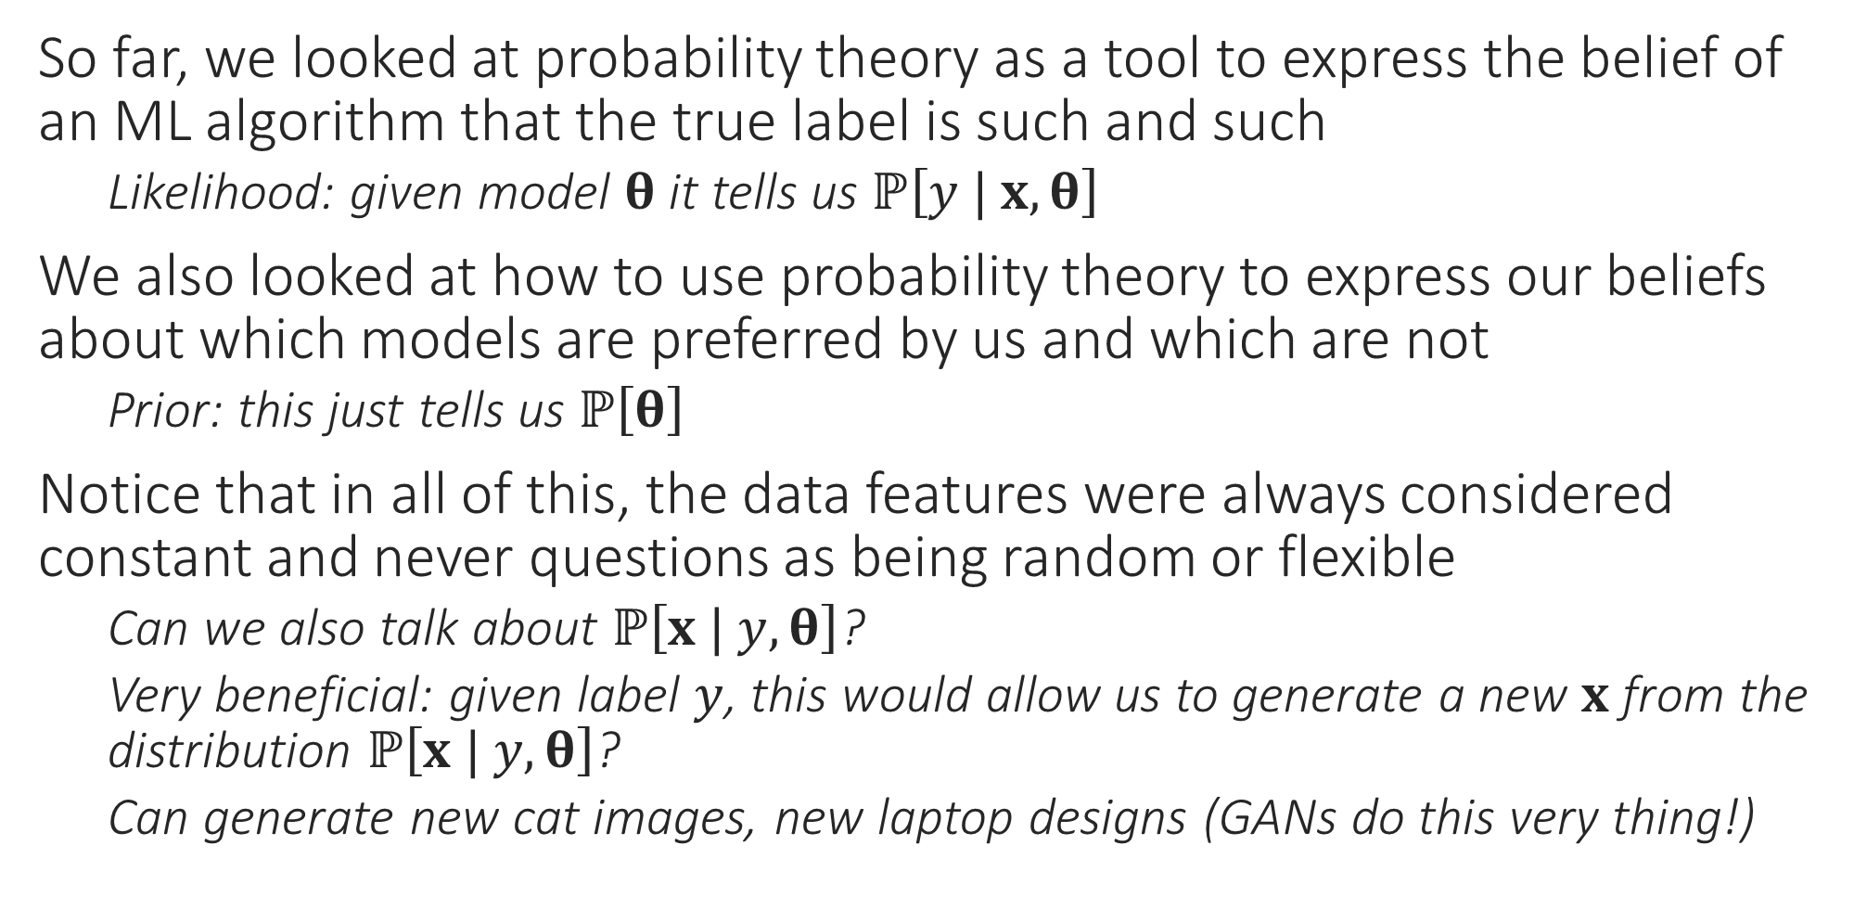
Generative Models
So far, we looked at probability theory as a tool to express the belief of an ML algorithm that the true label is such and such
Likelihood: given model $θ$ it tells us $ℙ\left[y | x,θ\right]$
We also looked at how to use probability theory to express our beliefs about which models are preferred by us and which are not
Prior: this just tells us $ℙ\left[θ\right]$
Notice that in all of this, the data features were always considered constant and never questions as being random or flexible
Can we also talk about $ℙ\left[x | y, θ\right]$?
Very beneficial: given label $y$, this would allow us to generate a new $x$ from the distribution $ℙ\left[x | y, θ\right]$?
Can generate new cat images, new laptop designs (GANs do this very thing!)

Slide 5
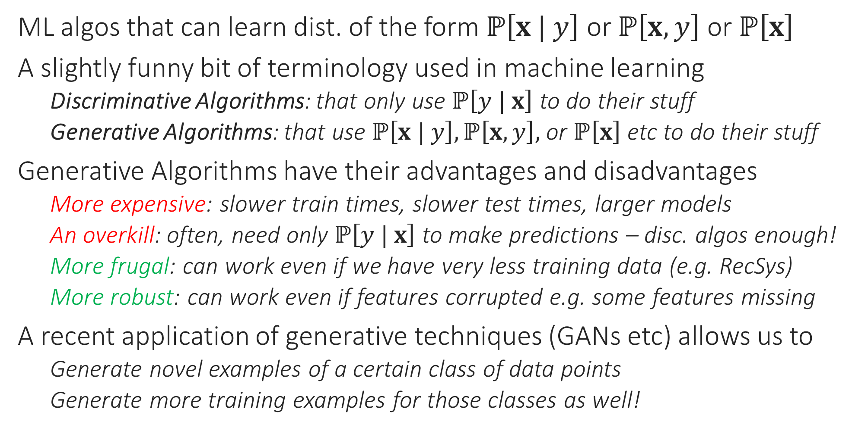
Generative Algorithms
ML algos that can learn dist. of the form $ℙ\left[x | y\right]$ or $ℙ\left[x,y\right]$ or $ℙ\left[x\right]$
A slightly funny bit of terminology used in machine learning
Discriminative Algorithms: that only use $ℙ\left[y | x\right]$ to do their stuff
Generative Algorithms: that use $ℙ\left[x | y\right],ℙ\left[x,y\right],$ or $ℙ\left[x\right]$ etc to do their stuff
Generative Algorithms have their advantages and disadvantages
More expensive: slower train times, slower test times, larger models
An overkill: often, need only $ℙ\left[y | x\right]$ to make predictions – disc. algos enough!
More frugal: can work even if we have very less training data (e.g. RecSys)
More robust: can work even if features corrupted e.g. some features missing
A recent application of generative techniques (GANs etc) allows us to
Generate novel examples of a certain class of data points
Generate more training examples for those classes as well!

Slide 6
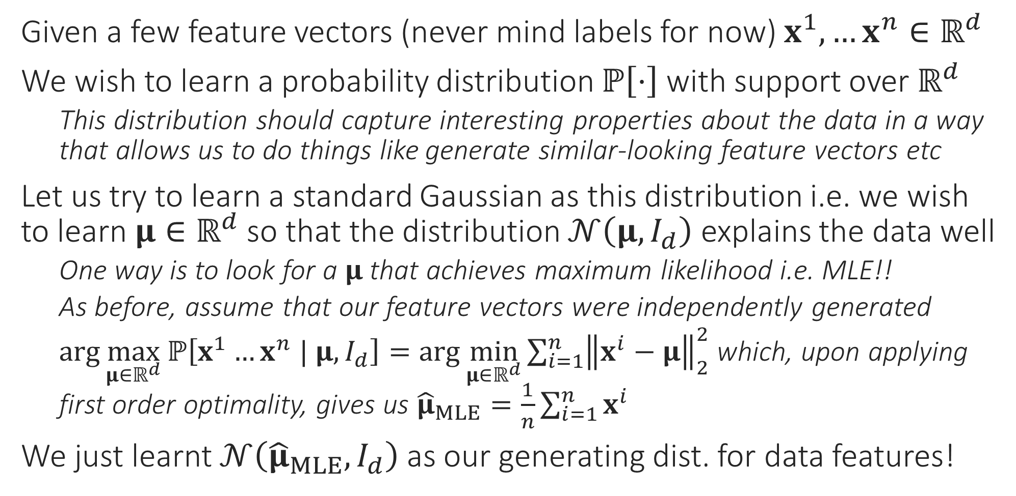
A very simple generative model
Given a few feature vectors (never mind labels for now) $x^{1},…x^{n}∈ℝ^{d}$
We wish to learn a probability distribution $ℙ\left[⋅\right]$ with support over $ℝ^{d}$
This distribution should capture interesting properties about the data in a way that allows us to do things like generate similar-looking feature vectors etc
Let us try to learn a standard Gaussian as this distribution i.e. we wish to learn $μ∈ℝ^{d}$ so that the distribution $𝒩\left(μ,I_{d}\right)$ explains the data well
One way is to look for a $μ$ that achieves maximum likelihood i.e. MLE!!
As before, assume that our feature vectors were independently generated
$\arg{\max_{μ∈ℝ^{d}}{ℙ\left[x^{1}…x^{n} | μ,I_{d}\right]}}=\arg{\min_{μ∈ℝ^{d}}{\sum_{i=1}^{n}{{\left\|x^{i}−μ\right\|}_{2}^{2}}}}$ which, upon applying first order optimality, gives us ${\hat{μ}}_{MLE}=\frac{1}{n}\sum_{i=1}^{n}{x^{i}}$
We just learnt $𝒩\left({\hat{μ}}_{MLE},I_{d}\right)$ as our generating dist. for data features!

Slide 7
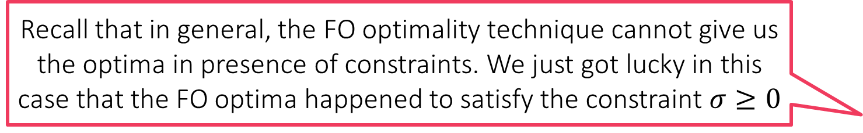
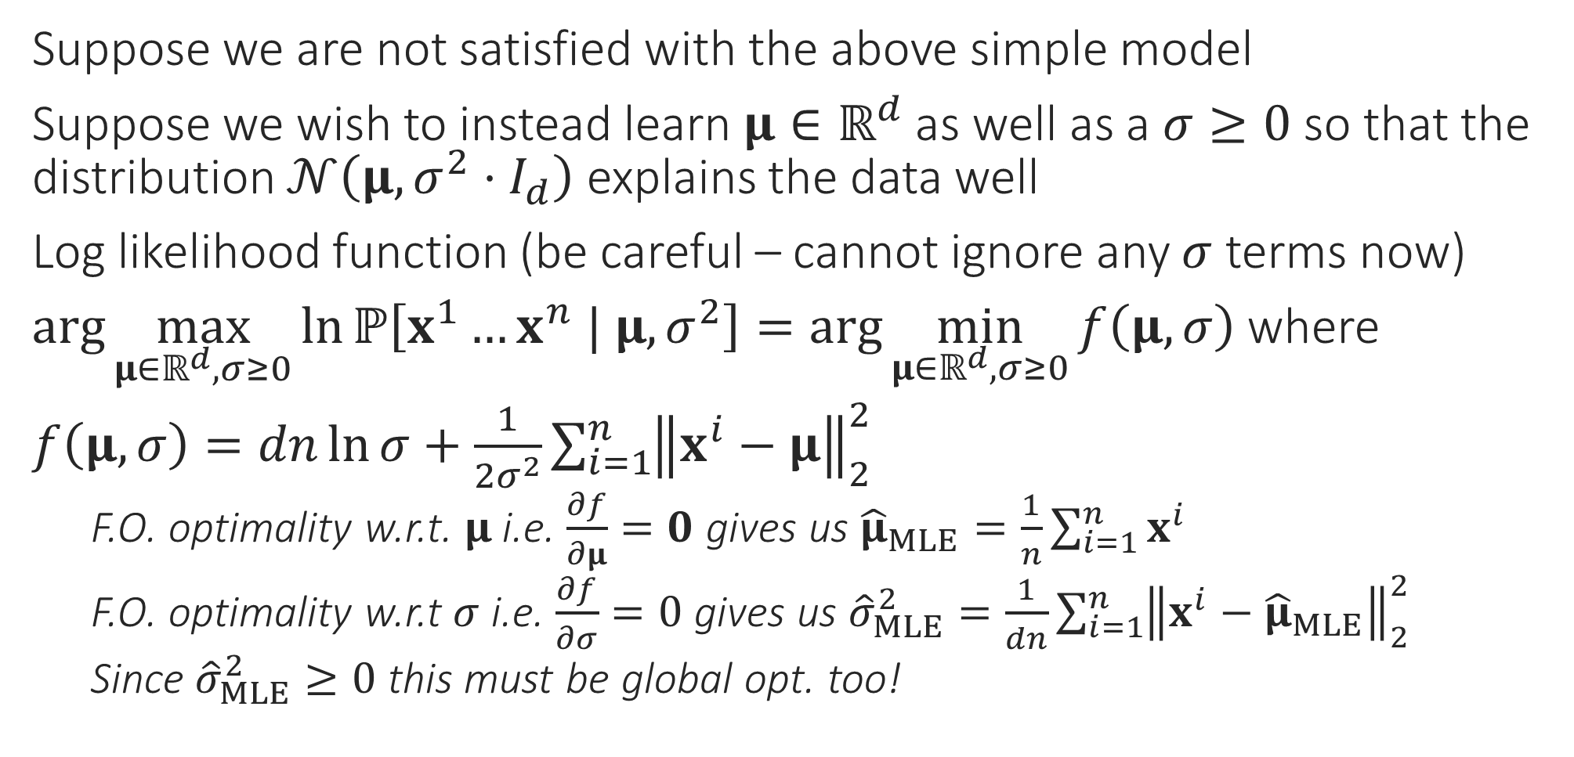
A more powerful generative model
Recall that in general, the FO optimality technique cannot give us the optima in presence of constraints. We just got lucky in this case that the FO optima happened to satisfy the constraint $σ≥0$
Suppose we are not satisfied with the above simple model
Suppose we wish to instead learn $μ∈ℝ^{d}$ as well as a $σ≥0$ so that the distribution $𝒩\left(μ,{σ^{2}⋅I}_{d}\right)$ explains the data well
Log likelihood function (be careful – cannot ignore any $σ$ terms now)
$\arg{\max_{μ∈ℝ^{d},σ≥0}{\ln{ℙ\left[x^{1}…x^{n} | μ,σ^{2}\right]}}}=\arg{\min_{μ∈ℝ^{d},σ≥0}{f\left(μ,σ\right)}}$ where
$f\left(μ,σ\right)=dn\ln{σ}+\frac{1}{2σ^{2}}\sum_{i=1}^{n}{{\left\|x^{i}−μ\right\|}_{2}^{2}}$
F.O. optimality w.r.t. $μ$ i.e. $\frac{∂f}{∂μ}=0$ gives us ${\hat{μ}}_{MLE}=\frac{1}{n}\sum_{i=1}^{n}{x^{i}}$
F.O. optimality w.r.t $σ$ i.e. $\frac{∂f}{∂σ}=0$ gives us ${\hat{σ}}_{MLE}^{2}=\frac{1}{dn}\sum_{i=1}^{n}{{\left\|x^{i}−{\hat{μ}}_{MLE}\right\|}_{2}^{2}}$
Since ${\hat{σ}}_{MLE}^{2}≥0$ this must be global opt. too!

Slide 8
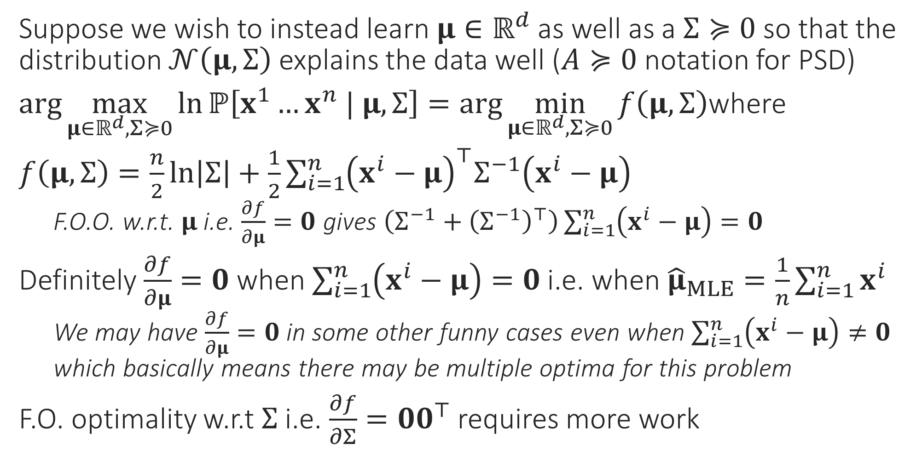
A still more powerful generative model
Suppose we wish to instead learn $μ∈ℝ^{d}$ as well as a $Σ≽0$ so that the distribution $𝒩\left(μ,Σ\right)$ explains the data well ($A≽0$ notation for PSD)
$\arg{\max_{μ∈ℝ^{d},Σ≽0}{\ln{ℙ\left[x^{1}…x^{n} | μ,Σ\right]}}}=\arg{\min_{μ∈ℝ^{d},Σ≽0}{f\left(μ,Σ\right)}}$where
$f\left(μ,Σ\right)=\frac{n}{2}\ln\left|Σ\right|+\frac{1}{2}\sum_{i=1}^{n}{{\left(x^{i}−μ\right)}^{⊤}Σ^{−1}\left(x^{i}−μ\right)}$
F.O.O. w.r.t. $μ$ i.e. $\frac{∂f}{∂μ}=0$ gives $\left(Σ^{−1}+{\left(Σ^{−1}\right)}^{⊤}\right)\sum_{i=1}^{n}{\left(x^{i}−μ\right)}=0$
Definitely $\frac{∂f}{∂μ}=0$ when $\sum_{i=1}^{n}{\left(x^{i}−μ\right)}=0$ i.e. when ${\hat{μ}}_{MLE}=\frac{1}{n}\sum_{i=1}^{n}{x^{i}}$
We may have $\frac{∂f}{∂μ}=0$ in some other funny cases even when $\sum_{i=1}^{n}{\left(x^{i}−μ\right)}≠0$ which basically means there may be multiple optima for this problem
F.O. optimality w.r.t $Σ$ i.e. $\frac{∂f}{∂Σ}={00}^{⊤}$ requires more work

Slide 9
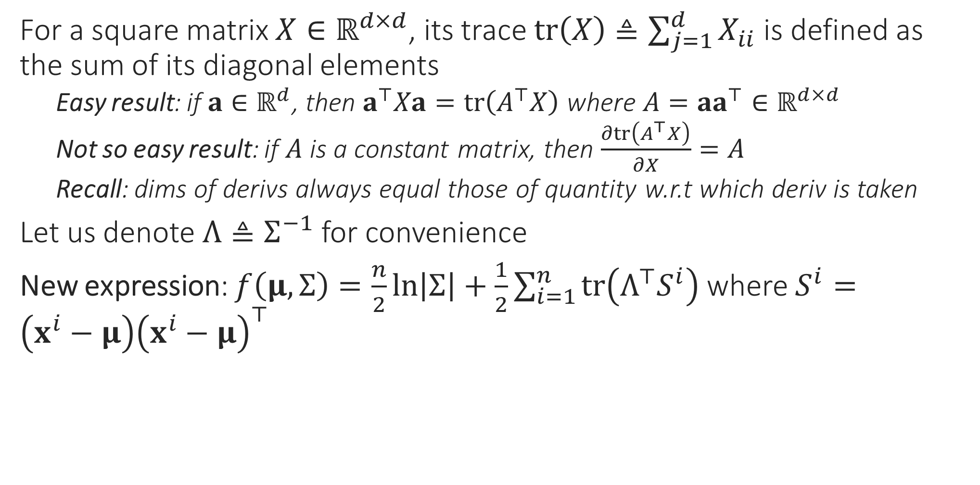
A still more powerful generative model
For a square matrix $X∈ℝ^{d×d}$, its trace $tr\left(X\right)≜\sum_{j=1}^{d}{X_{ii}}$ is defined as the sum of its diagonal elements
Easy result: if $a∈ℝ^{d}$, then $a^{⊤}Xa=tr\left(A^{⊤}X\right)$ where $A=aa^{⊤}∈ℝ^{d×d}$
Not so easy result: if $A$ is a constant matrix, then $\frac{∂tr\left(A^{⊤}X\right)}{∂X}=A$
Recall: dims of derivs always equal those of quantity w.r.t which deriv is taken
Let us denote $Λ≜Σ^{−1}$ for convenience
New expression: $f\left(μ,Σ\right)=\frac{n}{2}\ln\left|Σ\right|+\frac{1}{2}\sum_{i=1}^{n}{tr\left(Λ^{⊤}S^{i}\right)}$ where $S^{i}=\left(x^{i}−μ\right){\left(x^{i}−μ\right)}^{⊤}$

Slide 10
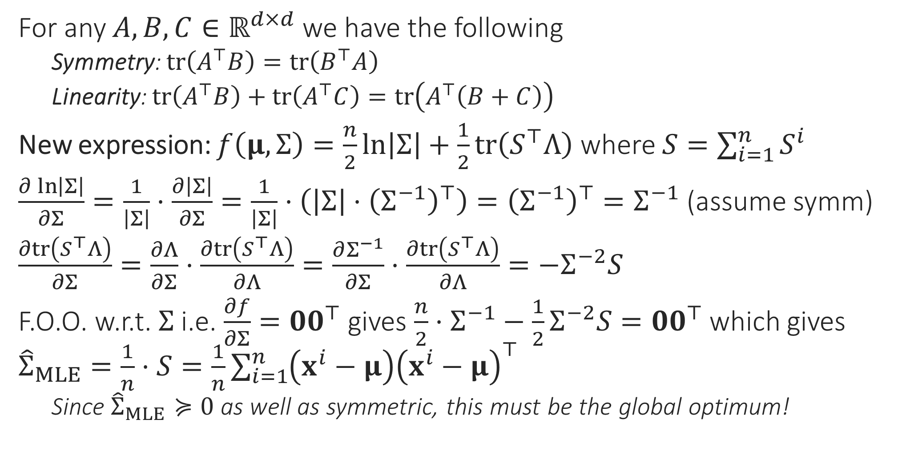
A still more powerful generative model
See “The Matrix Cookbook” (reference section on course webpage) for these results
For any $A,B,C∈ℝ^{d×d}$ we have the following
Symmetry: $tr\left(A^{⊤}B\right)=tr\left(B^{⊤}A\right)$
Linearity: $tr\left(A^{⊤}B\right)+tr\left(A^{⊤}C\right)=tr\left(A^{⊤}\left(B+C\right)\right)$
New expression: $f\left(μ,Σ\right)=\frac{n}{2}\ln\left|Σ\right|+\frac{1}{2}tr\left(S^{⊤}Λ\right)$ where $S=\sum_{i=1}^{n}{S^{i}}$
$\frac{∂\ln\left|Σ\right|}{∂Σ}=\frac{1}{\left|Σ\right|}⋅\frac{∂\left|Σ\right|}{∂Σ}=\frac{1}{\left|Σ\right|}⋅\left(\left|Σ\right|⋅{\left(Σ^{−1}\right)}^{⊤}\right)={\left(Σ^{−1}\right)}^{⊤}=Σ^{−1}$ (assume symm)
$\frac{∂tr\left(S^{⊤}Λ\right)}{∂Σ}=\frac{∂Λ}{∂Σ}⋅\frac{∂tr\left(S^{⊤}Λ\right)}{∂Λ}=\frac{∂Σ^{−1}}{∂Σ}⋅\frac{∂tr\left(S^{⊤}Λ\right)}{∂Λ}=−Σ^{−2}S$
F.O.O. w.r.t. $Σ$ i.e. $\frac{∂f}{∂Σ}=00^{⊤}$ gives $\frac{n}{2}⋅Σ^{−1}−\frac{1}{2}Σ^{−2}S={00}^{⊤}$ which gives ${\hat{Σ}}_{MLE}=\frac{1}{n}⋅S=\frac{1}{n}\sum_{i=1}^{n}{\left(x^{i}−μ\right){\left(x^{i}−μ\right)}^{⊤}}$
Since ${\hat{Σ}}_{MLE}≽0$ as well as symmetric, this must be the global optimum!

Slide 11
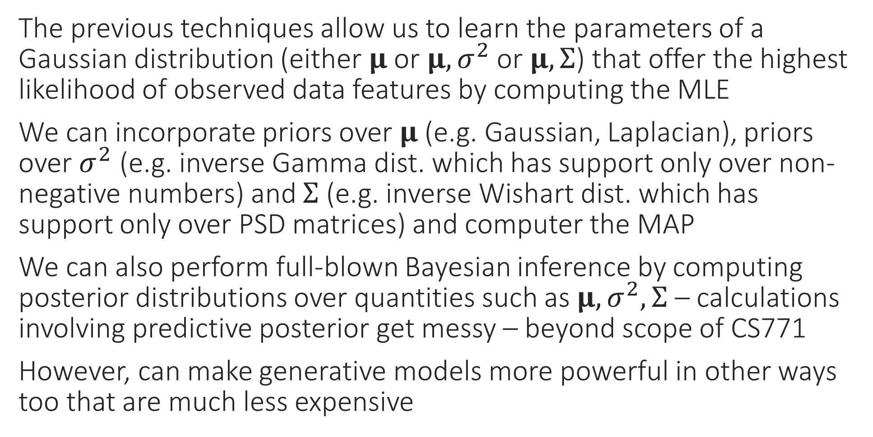
MAP, Bayesian Generative Models?
The previous techniques allow us to learn the parameters of a Gaussian distribution (either $μ$ or $μ,σ^{2}$ or $μ,Σ$) that offer the highest likelihood of observed data features by computing the MLE
We can incorporate priors over $μ$ (e.g. Gaussian, Laplacian), priors over $σ^{2}$ (e.g. inverse Gamma dist. which has support only over non-negative numbers) and $Σ$ (e.g. inverse Wishart dist. which has support only over PSD matrices) and computer the MAP
We can also perform full-blown Bayesian inference by computing posterior distributions over quantities such as $μ,σ^{2},Σ$ – calculations involving predictive posterior get messy – beyond scope of CS771
However, can make generative models more powerful in other ways too that are much less expensive

Slide 12
Still more powerful generative model?
Suppose we are concerned that a single Gaussian cannot capture all the variations in our data
Just as in LwP when we realized sometimes, a single prototype not enough
Can we learn 2 (or more) Gaussians to represent our data instead?
Such a generative model is often called a mixture of Gaussians
The Expectation Maximization (EM) algorithm is a very powerful technique for performing this and several other tasks
Soft clustering, learning Gaussian mixture models (GMM)
Robust learning, Mixed Regression
Also underlies more powerful variational algorithms such as VAE

Slide 13


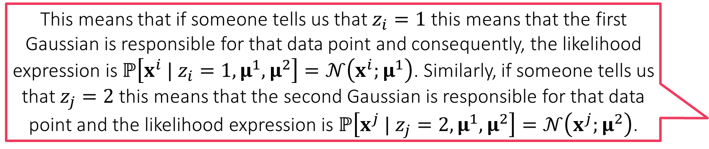

Learning a Mixture of Two Gaussians
This means that if someone tells us that $z_{i}=1$ this means that the first Gaussian is responsible for that data point and consequently, the likelihood expression is $ℙ\left[x^{i} | z_{i}=1,μ^{1},μ^{2}\right]=𝒩\left(x^{i};μ^{1}\right)$. Similarly, if someone tells us that $z_{j}=2$ this means that the second Gaussian is responsible for that data point and the likelihood expression is $ℙ\left[x^{j} | z_{j}=2,μ^{1},μ^{2}\right]=𝒩\left(x^{j};μ^{2}\right)$.
We suspect that instead of one Gaussian, two Gaussians are involved in generating our feature vectors
Let us call them $𝒩\left(μ^{1},I_{d}\right)$ and $𝒩\left(μ^{2},I_{d}\right)$
Each of these is called a component of this GMM
Covariance matrices, more than two components can also be incorporated
Since we are unsure which data point came from which component, we introduce a latent variable $z_{i}∈\left\{1,2\right\}$ per data point to denote this
The English word “latent” means hidden or dormant or concealed
Nice name since this variable describes something that was hidden from us
These latent variables may seem similar to the one we used in (soft) k-means
Not an accident – the connections will be clear soon!
Latent variables can be discrete or continuous

Slide 14
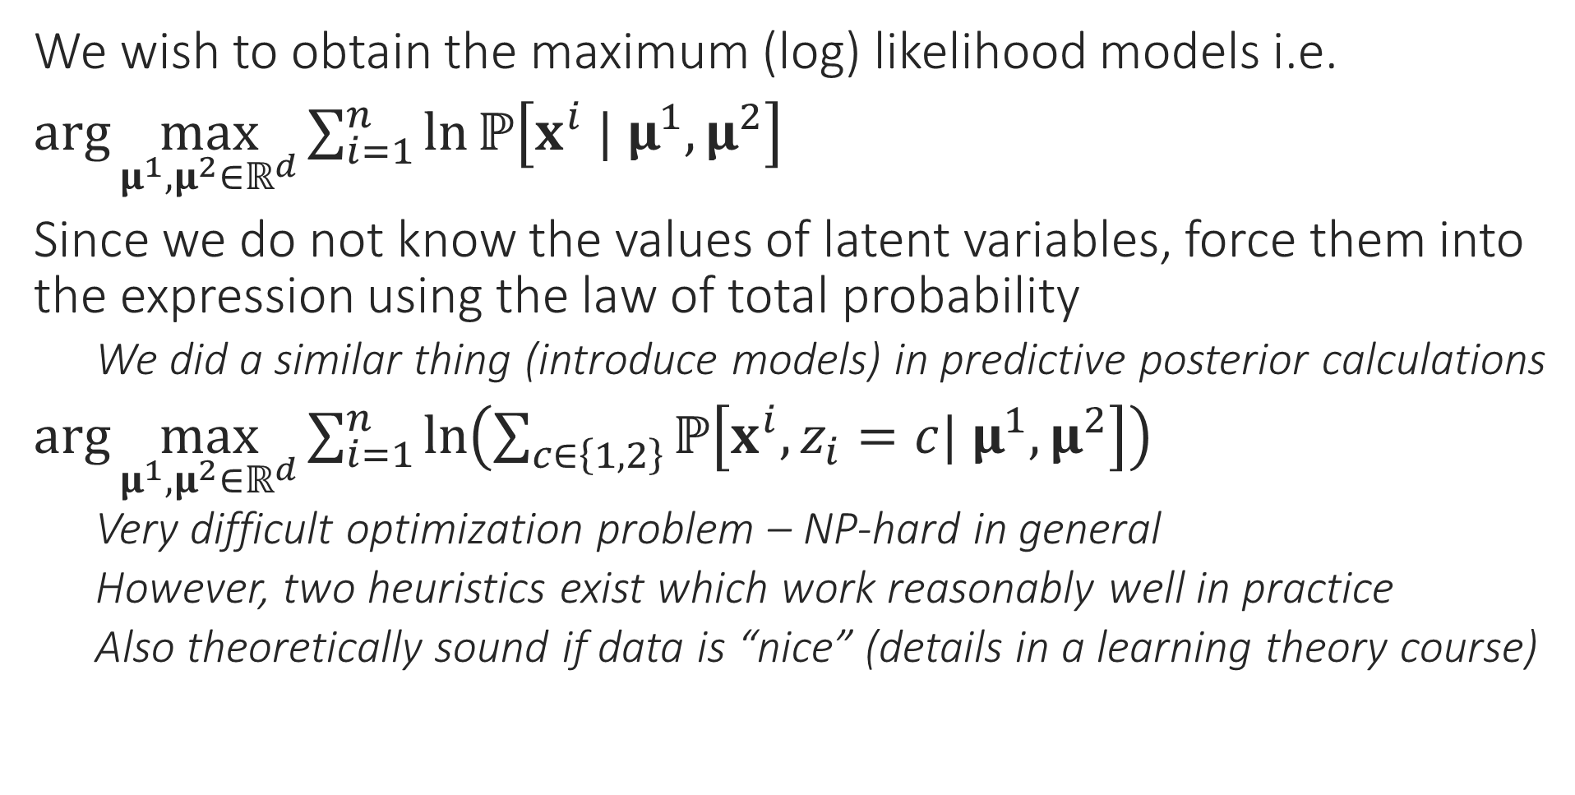
MLE with Latent Variables
We wish to obtain the maximum (log) likelihood models i.e.
$\arg{\max_{μ^{1},μ^{2}∈ℝ^{d}}{\sum_{i=1}^{n}{\ln{ℙ\left[x^{i} | μ^{1},μ^{2}\right]}}}}$
Since we do not know the values of latent variables, force them into the expression using the law of total probability
We did a similar thing (introduce models) in predictive posterior calculations
$\arg{\max_{μ^{1},μ^{2}∈ℝ^{d}}{\sum_{i=1}^{n}{\ln\left(\sum_{c∈\left\{1,2\right\}}{ℙ\left[x^{i},z_{i}=c| μ^{1},μ^{2}\right]}\right)}}}$
Very difficult optimization problem – NP-hard in general
However, two heuristics exist which work reasonably well in practice
Also theoretically sound if data is “nice” (details in a learning theory course)

Slide 15


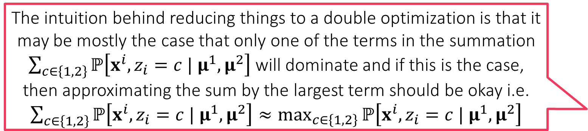
Heuristic 1: Alternating Optimization
Keep alternating between step 1 and step 2 till you are tired or till the process has converged!
Convert the original optimization problem
$\arg{\max_{μ^{1},μ^{2}∈ℝ^{d}}{\sum_{i=1}^{n}{\ln\left(\sum_{c∈\left\{1,2\right\}}{ℙ\left[x^{i},z_{i}=c | μ^{1},μ^{2}\right]}\right)}}}$
to a double maximization problem (assume $ℙ\left[z_{i} | μ^{1},μ^{2}\right]=$ const)
$\underset{μ^{1},μ^{2}∈ℝ^{d}}{argmax}{\underset{z_{i}∈\left\{1,2\right\}}{argmax}{\sum_{i=1}^{n}{\ln{ℙ\left[x^{i} | z_{i},μ^{1},μ^{2}\right]}}}}$
In several ML problems with latent vars, although the above double optimization problem is (still) difficult, following two problems are easy
Step 1: Fix $μ^{1},μ^{2}∈ℝ^{d}$ and update latent variables $z_{i}$ to their optimal values
$\arg{\max_{z_{i}∈\left\{1,2\right\}}{\sum_{i=1}^{n}{\ln{ℙ\left[x^{i} | z_{i},μ^{1},μ^{2}\right]}}}}=\arg{\max_{z_{i}∈\left\{1,2\right\}}{\ln{ℙ\left[x^{i} | z_{i},μ^{1},μ^{2}\right]}}}$
Step 2: Fix latent variables $z_{i}$ and update $μ^{1},μ^{2}∈ℝ^{d}$ to their optimal values
$\arg{\max_{μ^{1},μ^{2}∈ℝ^{d}}{\sum_{i=1}^{n}{\ln{ℙ\left[x^{i} | z_{i},μ^{1},μ^{2}\right]}}}}$
The intuition behind reducing things to a double optimization is that it may be mostly the case that only one of the terms in the summation $\sum_{c∈\left\{1,2\right\}}{ℙ\left[x^{i},z_{i}=c | μ^{1},μ^{2}\right]}$ will dominate and if this is the case, then approximating the sum by the largest term should be okay i.e. $\sum_{c∈\left\{1,2\right\}}{ℙ\left[x^{i},z_{i}=c | μ^{1},μ^{2}\right]}≈\max_{c∈\left\{1,2\right\}}{ℙ\left[x^{i},z_{i}=c | μ^{1},μ^{2}\right]}$
The most important difference between the original and the new problem is that original has a sum of log of sum which is very difficult to optimize whereas the new problem gets rid of this and looks simply like a MLE problem. We know how to solve MLE problems very easily!

Slide 16


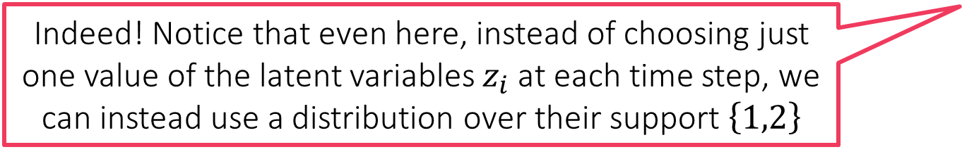
Heuristic 1 at Work
Isn’t this like the k-means algorithm?
As discussed before, we assume a mixture of two Gaussians
$ℙ\left[x^{i} | z_{i}=1,μ^{1},μ^{2}\right]=𝒩\left(x^{i};μ^{1}\right)$ and $ℙ\left[x^{j} | z_{j}=2,μ^{1},μ^{2}\right]=𝒩\left(x^{j};μ^{2}\right)$
Step 1 becomes
$\arg{\max_{z_{i}∈\left\{1,2\right\}}{\ln{ℙ\left[x^{i} | z_{i},μ^{1},μ^{2}\right]}}}={\arg{\min_{z_{i}∈\left\{1,2\right\}}\left\|x^{i}−μ^{z_{i}}\right\|}}_{2}^{2}$
Step 2 becomes
$\arg{\max_{μ^{1},μ^{2}∈ℝ^{d}}{\sum_{i=1}^{n}{\ln{ℙ\left[x^{i} | z_{i},μ^{1},μ^{2}\right]}}}}$
$=\arg{\min_{μ^{1} ∈ℝ^{d}}{\sum_{i:z_{i}=1}{{\left\|x^{i}−μ^{1}\right\|}_{2}^{2}}}}+\arg{\min_{μ^{2}∈ℝ^{d}}{\sum_{i:z_{i}=2}{{\left\|x^{i}−μ^{2}\right\|}_{2}^{2}}}}$
Thus, $μ^{1}=\frac{1}{n_{1}}\sum_{i:z_{i}=1}{x^{i}}$ and $μ^{2}=\frac{1}{n_{2}}\sum_{i:z_{i}=2}{x^{i}}$ where $n_{c}$ is the number of data points for which we have $z_{i}=c$
Repeat!
Not just “like” – this is the k-means algorithm! This means that the k-means algorithm is one heuristic way to compute an MLE which is difficult to compute directly!
Indeed! Notice that even here, instead of choosing just one value of the latent variables $z_{i}$ at each time step, we can instead use a distribution over their support $\left\{1,2\right\}$
I have a feeling that the second heuristic will also give us something we have already studied!

